Slide 1


Design of a development platform to monitor and manage Low Power, Wide Area WSNs

Slide 2


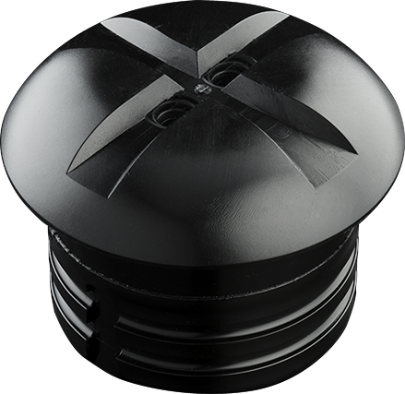

Problems
Performance monitoring (QoS)
Resource constraint
Operated networks

Slide 3
Overview
Problem
Goal
Developed solutions
Distributed development platform
Resource Distribution Model
Case study
Conclusions

Slide 4
Goal
Research and develop a software platform to monitor and manage QoS parameters of LPWA WSN applications.
How can we design abstract platform architecture for scalable processing of streams of raw sensor performance data?
How can we model the state and evaluate the QoS of a configurable system?

Slide 5
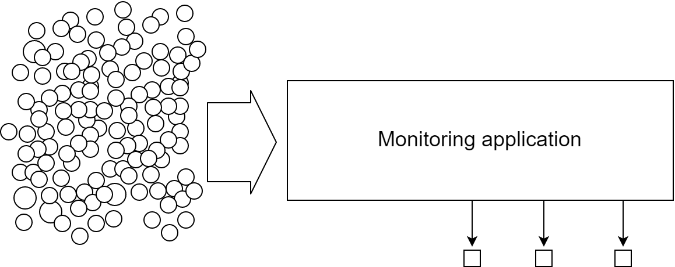
Platform architecture context

Slide 6
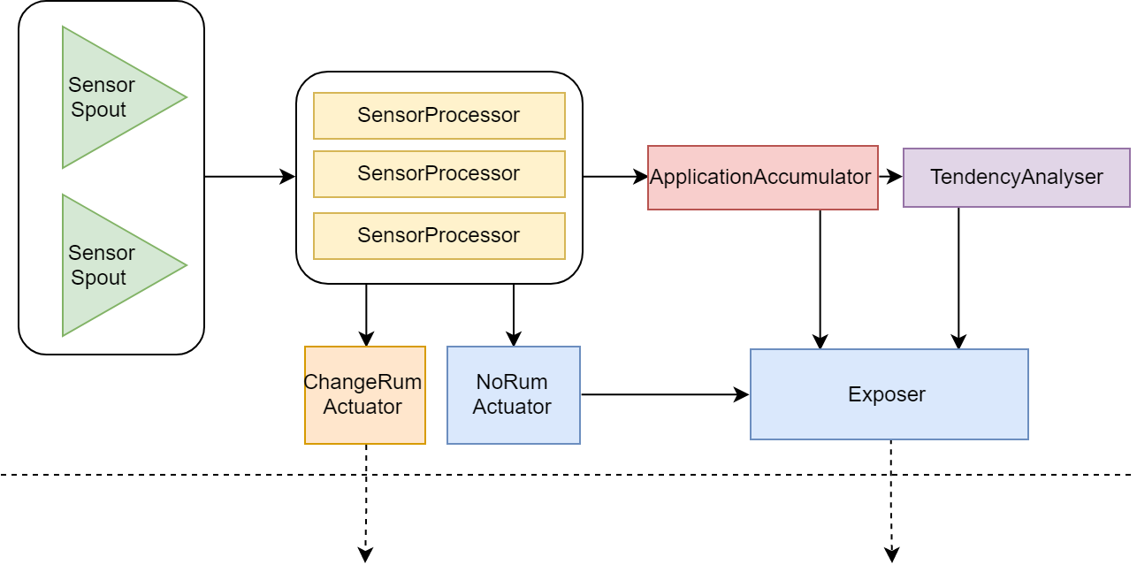
platform architecture micro-component topology

Slide 7
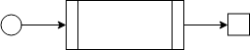
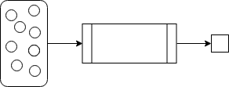
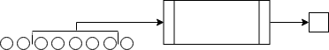
platform architecture stream operation types
Transformation
Lateral aggregation
Longitudinal aggregation

Slide 8
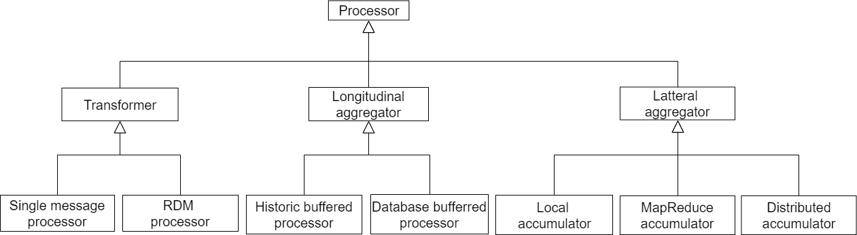
platform architecture component scaffolds

Slide 9
Research questions (2)
How can we design abstract platform architecture for scalable processing of streams of raw sensor performance data?
How can we model the state and evaluate the QoS of a configurable system

Slide 10
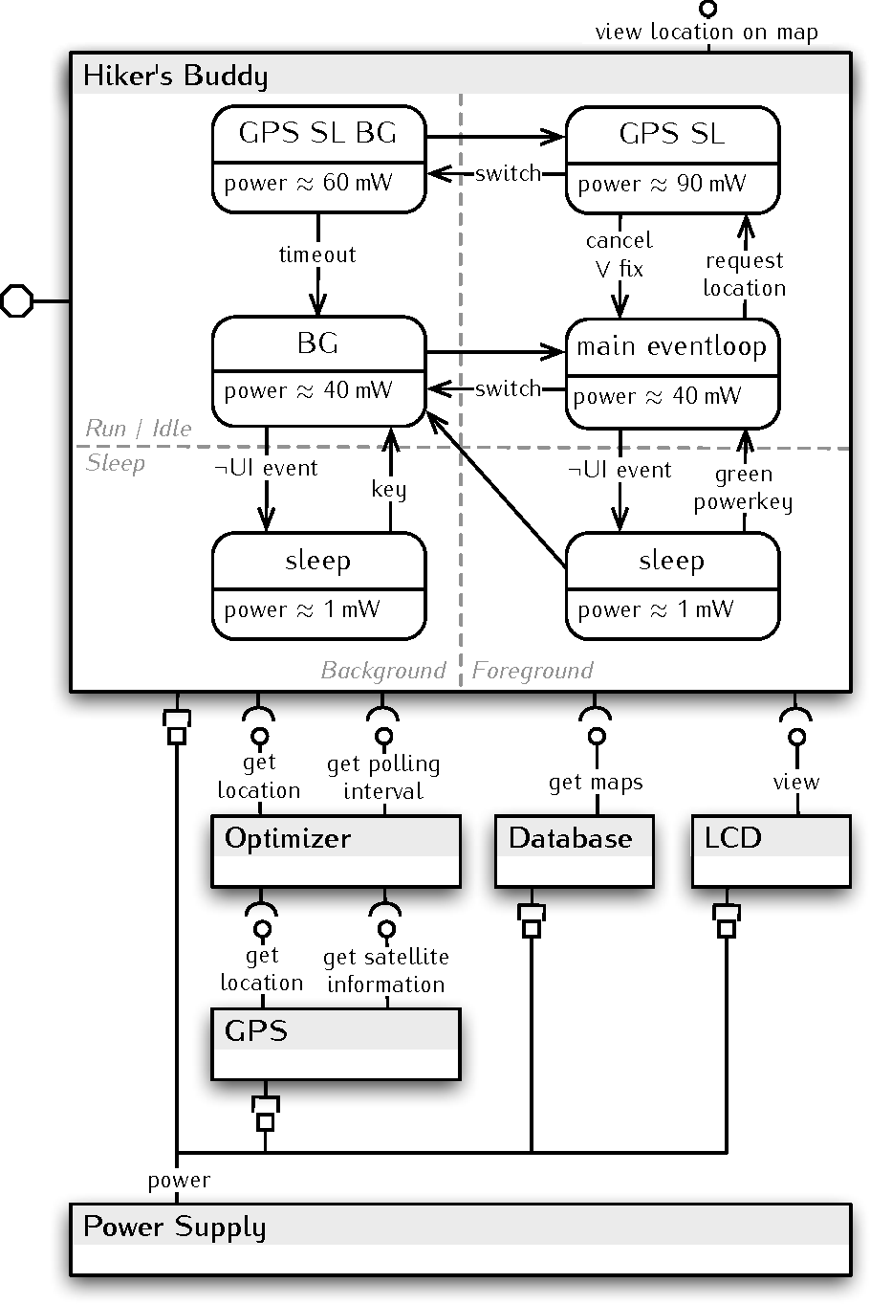
Resource Distribution Model (rdm) previous work
Resources & Components
Resource Utilization Model (RUM)
(Timed) state machines
Source:
Towards Modular Resource-Aware Applications
Somayeh Malakuti, et al.

Slide 11
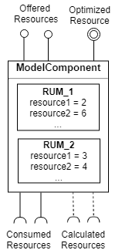
Resource Distribution Model (rdm)
Multiple RUMs
Constraints on resource distribution
Optimized resource
Constraint solver

Slide 12
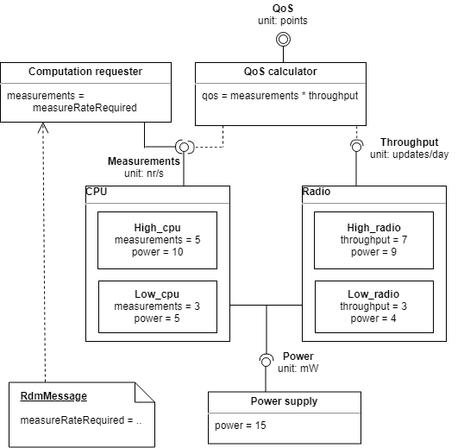
Resource Distribution Model Simple example
CPU
Configurable
Imposed min. measure rate
Radio module
configurable
Battery
Specified max. power
Goal:
Max. measure & message rate

Slide 13
Case study Context
Simulation Nedap SENSIT
Multi-level reporting
sensor-level adjustments
application-level outputs

Slide 14
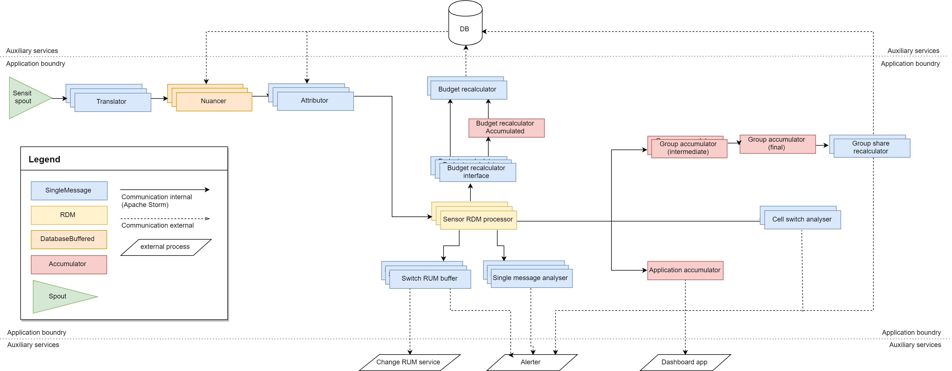
Case study distributed topology

Slide 15
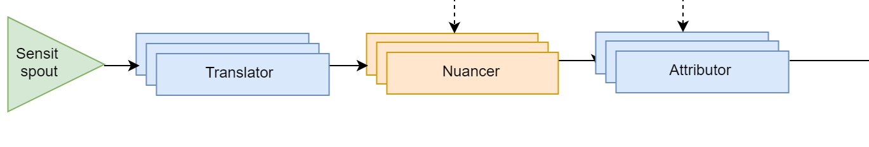
Case study Application topology

Slide 16
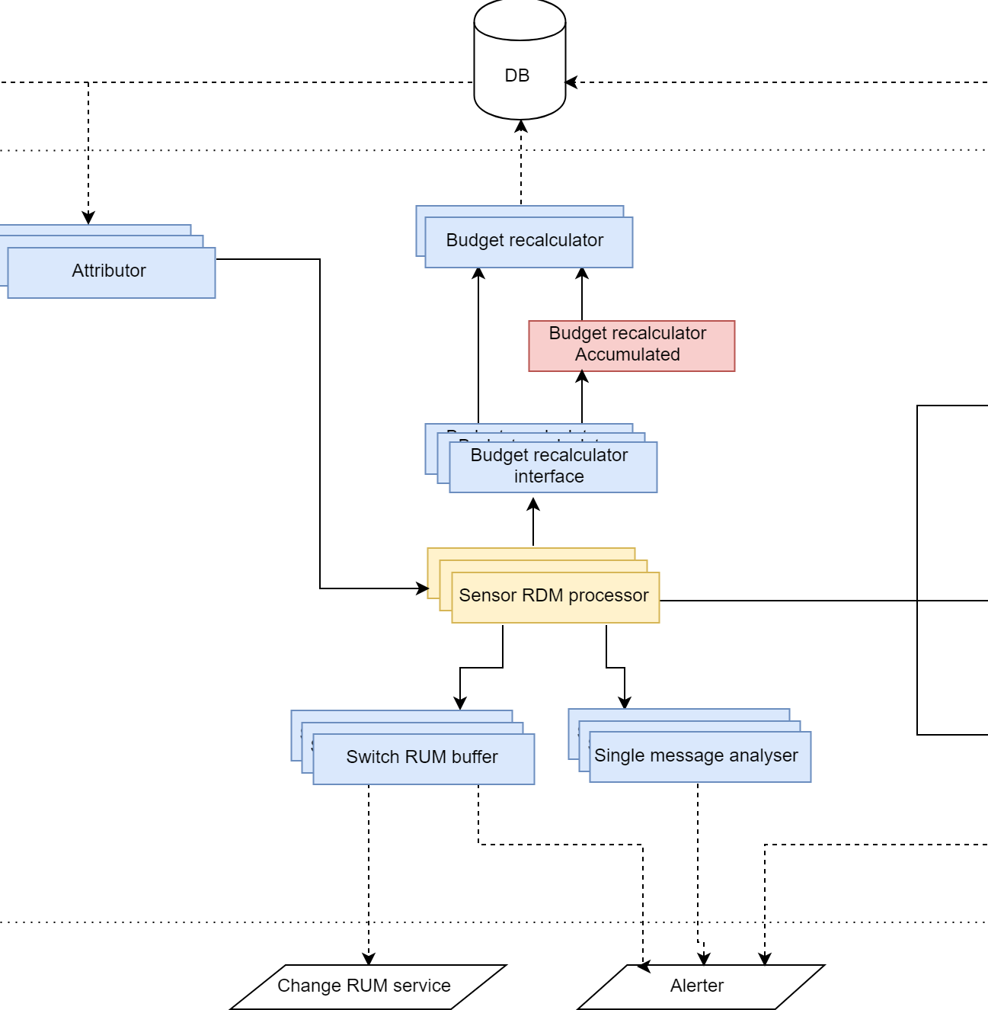
Case study Application topology

Slide 17
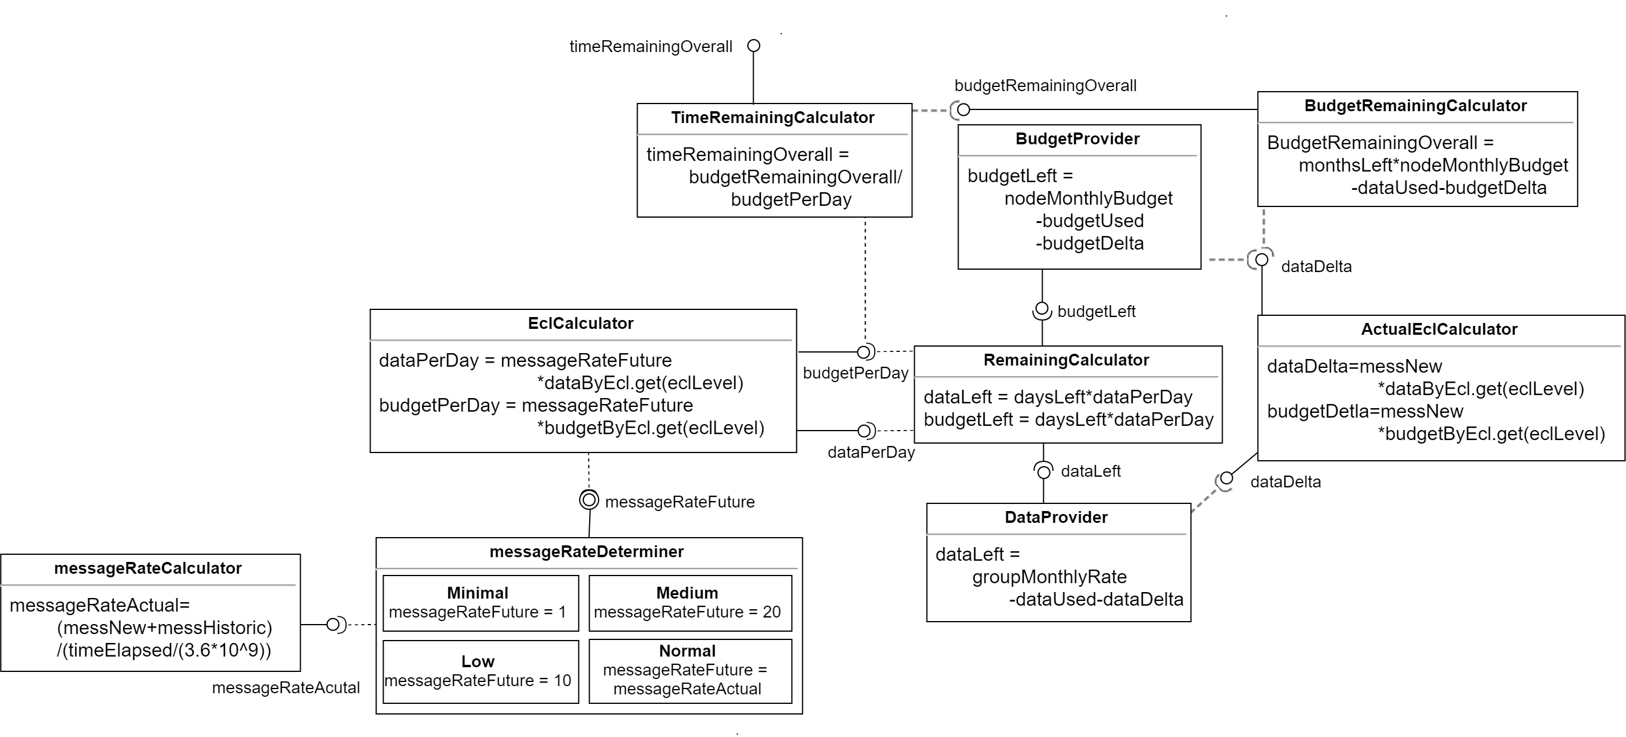
Case study Sensor RDM

Slide 18
Case study Application topology

Slide 19
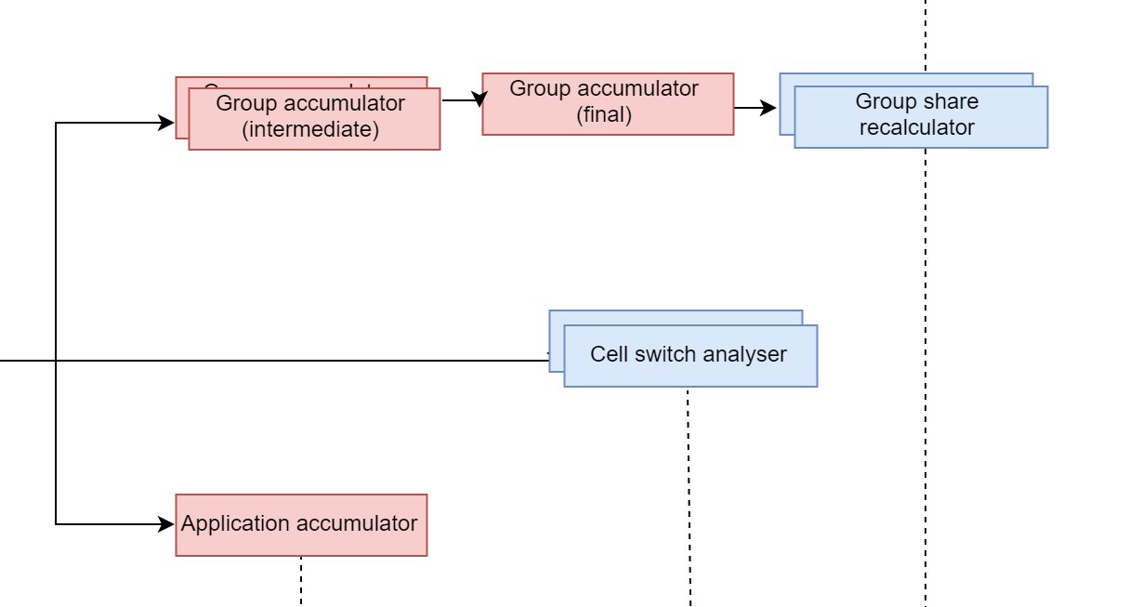
Case study Application topology

Slide 20


Validation study
Applicability
Usability
Adaptability

Slide 21
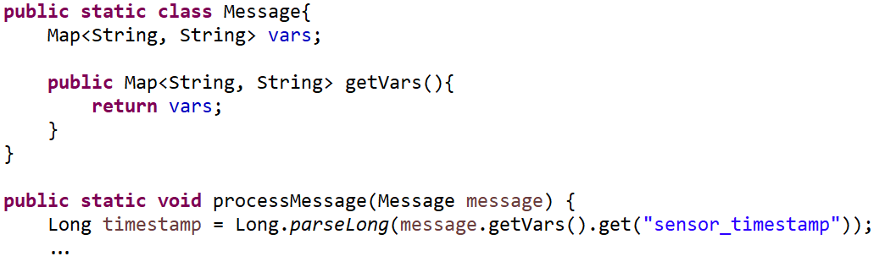
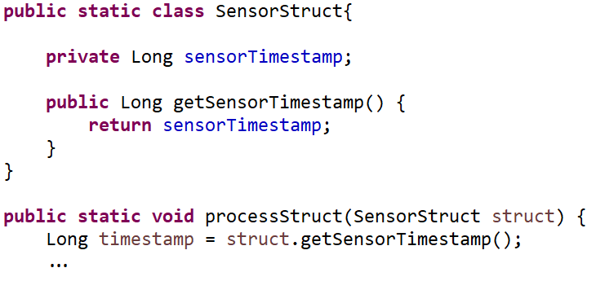
Validation study Invalid claim

Slide 22
Conclusions
Distributed architecture
Promising
Requires improvements
Resource Distribution Model
Effective
Efficient
Requires proper validation

Slide 23
Future work
Improvements to identified problems
Better incorporation of Apache Storm
Continued validation

Slide 24
Questions?

